Slide 1

Library Management system (Lms)
Semester Project DBMS
Notes:
NOTE:
To change the image on this slide, select the picture and delete it. Then click the Pictures icon in the placeholder to insert your own image.

Slide 2
Group Members
Saima Sajjad Soomro
Waqar Rao

Slide 3
Problem Statement
In library it is very difficult for us to manage the records of books that which book is issued to which students. All things will be managed manually so it is very hectic for us to add , update and delete the records . So to reduce this we make a system for library who manages all these things.

Slide 4
Solution
We make a library management system in which we add, update, delete, search and issue the book through this we get relief from manual work. User can check the information of those student and teacher who issued the book from library.

Slide 5
Introduction of Project
In this project we can add, update, delete and search the records of books.
Easy to use and gives fast result.
User friendly Graphical User Interface (GUI).
It reduced manual work and solved the complex problem easily.
It is a desktop application we can also use on other System as well

Slide 6
Implementation in Java Backend Database MySQL
We use MySQL Database for storing of records
It is an open-source relational database management systems
Efficient to use
Front-end Implementation in Java
Use Different Components of Java like jFrames, Jbuttons, textbox and tables
Use JDBS MySQL drivers for making connection between Java and MySQL database

Slide 7
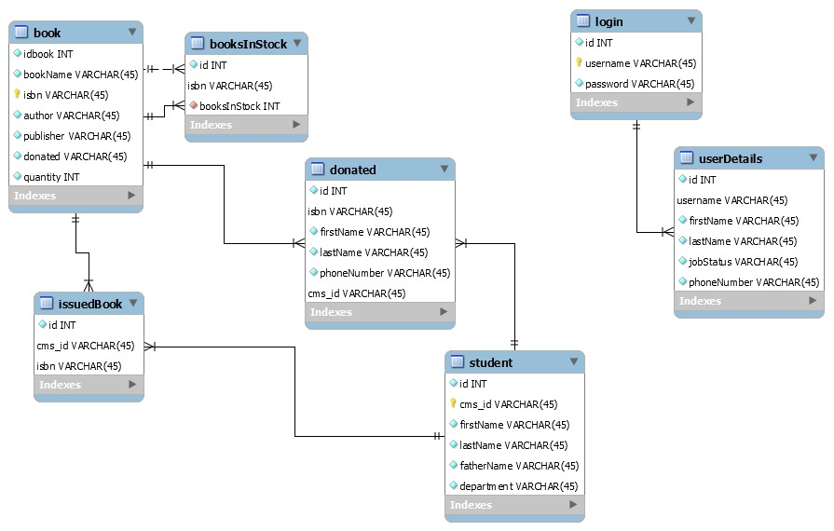
ER Diagram

Slide 8
Tables in Database
Book(Details of books)
BookInStock (Those books which are available in stock)
Donated(Details of person who donate book in library)
Students(Details of students)
Login(authentication purpose)
UserDetails(When creating accounts)
IssuedBook(Book issue by)

Slide 9
Conclusion
We use all the concepts which we learned in this Course like
Creating tables
Conceptual schemas
Writing queries etc

Slide 10
Demo of Project

